Slide 1
Chapter 6: Trees Part 2: Binary Search Trees

Slide 2
Learning outcomes of this part
LO4.1 Define general tree, Binary Tree and Binary Search Tree (BST).
LO4.2 Given a BST , draw resulted tree after an insert/ delete operations
LO4.3 Find the smallest and largest elements, number of nodes in a
tree and its’ height.
LO4.4 Write code to implement features of a binary search tree, such as insertion, deletion, searching, traversals, nodes and height calculation,rotation ...
LO4.5 Derive the time complexities for the above operations on a BST.
LO4.6: Compare a BST over other data structures
LO4.7: Identify applications where a binary search tree will be useful.

Slide 3
Objectives & Contents
What is binary search tree (BST)?
What are BST’s properties?
How to describe a node?
How to manager a tree?
When are BSTs used?
Demo.: BST of integers
Algorithms on BST:
Add new node
Getting minimum, maximum values
Getting tree’s height
Searching
Deleting
The given demonstration must be implemented by yourself and your works will be evaluated.

Slide 4
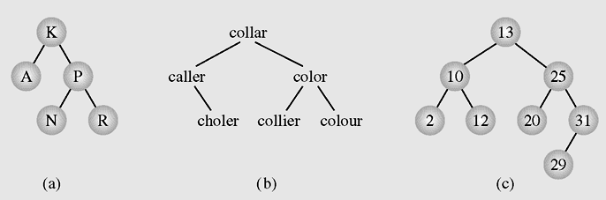
Binary Search Tree: Introduction
Binary Search tree is an orderly binary tree whose nodes are designated at exactly positions based on pre-defined comparison function.
Common used order:
Data in left child node < data in father node < data in right child node
LNR order in briefly.
Examples of binary search trees

Slide 5
BST: Introduction …
Natural orders:
On numbers: numerical comparison
On characters, strings: Dictionary order → ASCII comparison
Examples of binary search trees

Slide 6
BST: Introduction …
Order of User-defined Objects:
Programmer must define a comparion method. This method must return an integer.
In Java, the method int compare(T obj1, T obj2) (interface Comparator) or int CompareTo (T obj) (interface Comparable) must be overrided in the class of data object.
For more details: Please read the tutorial “Ex02-UseTreeSet.docx”.

Slide 7
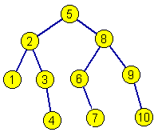
BST’s Properties
Minimum and maximum values are put at leftmost and rightmost positions of the tree.
Complexity of these operations are improved.
Searching operation will not need to traverse all nodes but a path will be chosen ( searching x= 7)

Slide 8
BST Node Description and Managing a BST
Node
BST
Data
Node root
Node left
Node right

Slide 9
When are BSTs used?
It is recommended to use when managing a collection of items in which search operations are frequently used. → Search operation must be improved → All elements are stored in pre-defined order.
In Java, please override methods:
int compare(T obj1, T obj2) (interface Comparator)
or
int CompareTo (T obj) (interface Comparable)

Slide 10
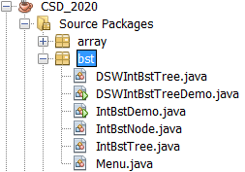
Demo.: BST of Integers
Program structure:

Slide 11
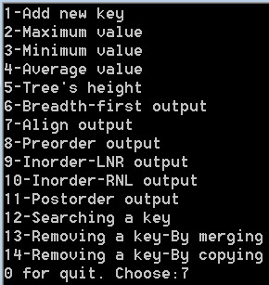
Demo.: BST of Integers
Program User Interface:

Slide 12
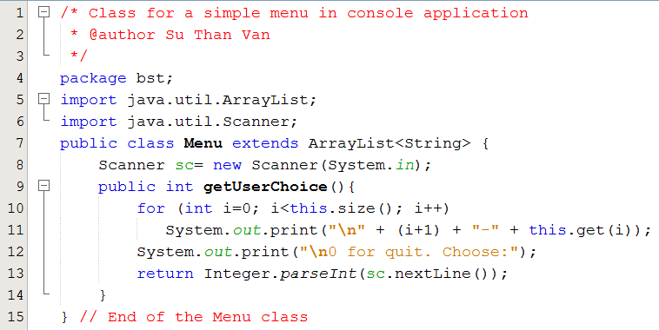
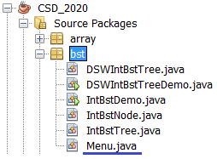
Demo.: BST of Integers

Slide 13
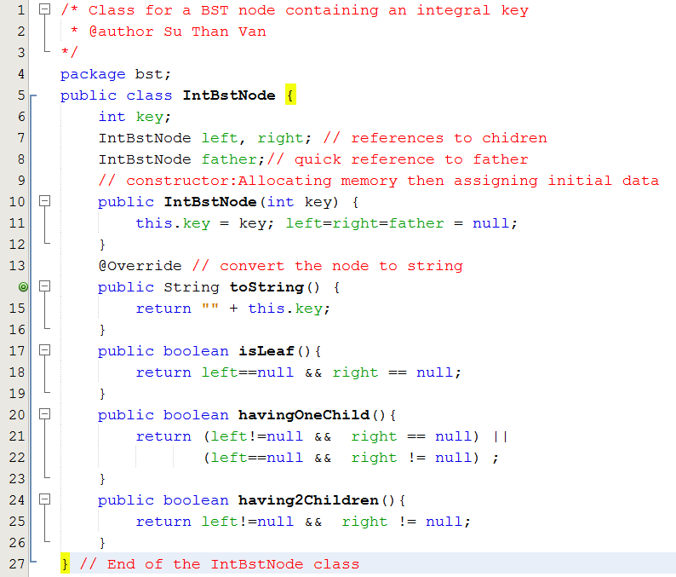
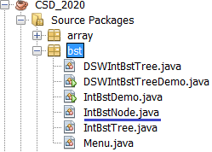
Demo.: BST of Integers

Slide 14
Algorithms on BSTs
Managing, Initializing
Add new node
Getting minimum, maximum values
Getting tree’s height
Traversing
Searching
Deleting

Slide 15
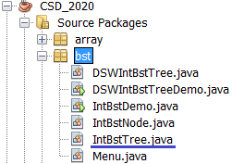
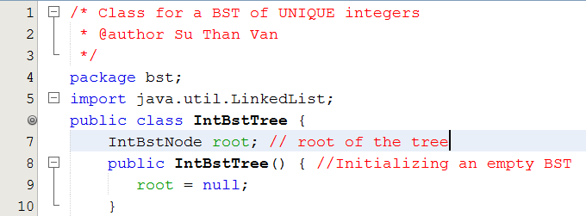
Alg.: Manage, Initialize BST

Slide 16
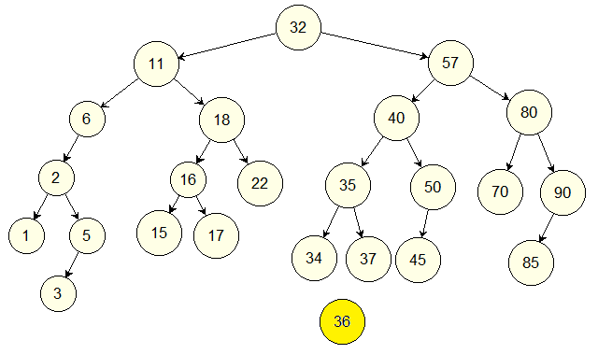
Alg.: Add data (x=36)
pAfter=null
root
The IntBstTree class
pBefore=root
pAfter
pBefore
newNode
Complexity: O(height)

Slide 17
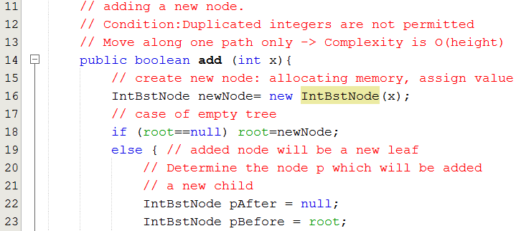
Alg.: Add data x
The IntBstTree class

Slide 18
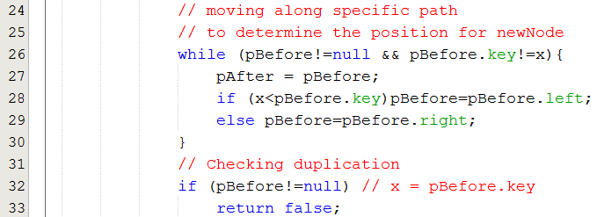
Alg.: Add data x
The IntBstTree clas

Slide 19
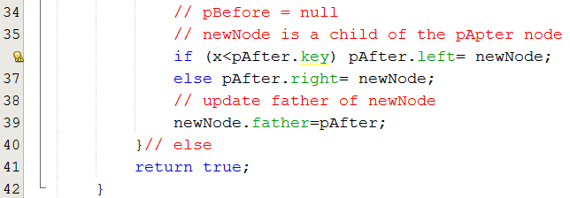

Alg.: Add data x
The IntBstTree clas

Slide 20
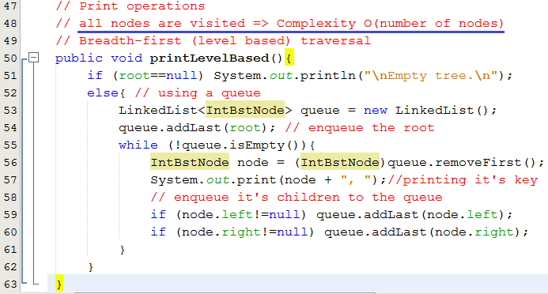
Alg.: Traversals for printing
The IntBstTree class

Slide 21
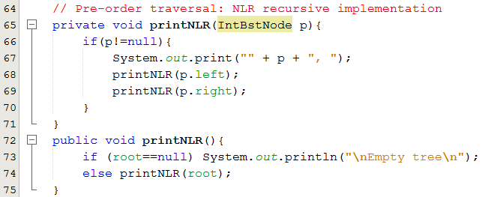
Alg.: Traversals for printing
The IntBstTree class

Slide 22
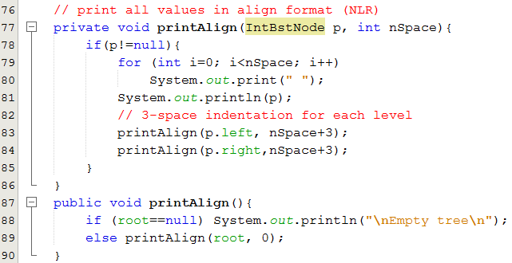

Alg.: Traversals for printing
The IntBstTree class

Slide 23
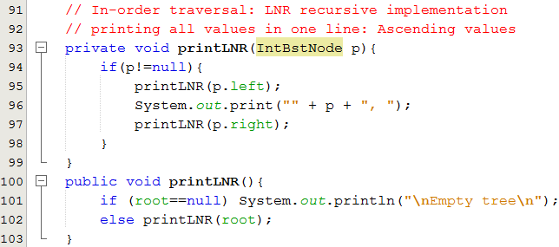
Alg.: Traversals for printing
The IntBstTree class

Slide 24
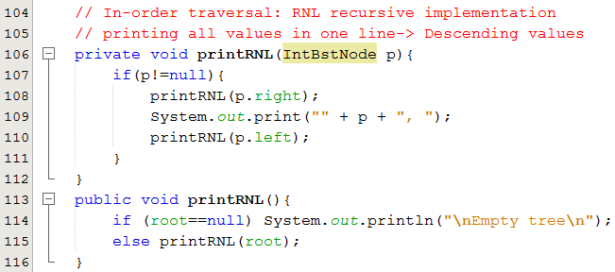
Alg.: Traversals for printing
The IntBstTree class

Slide 25
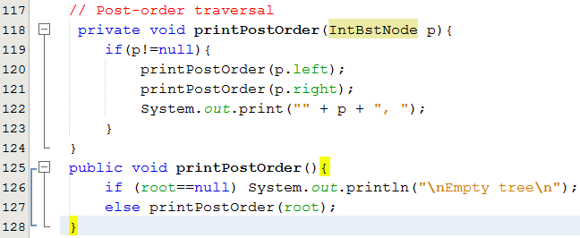
Alg.: Traversals for printing
The IntBstTree class

Slide 26
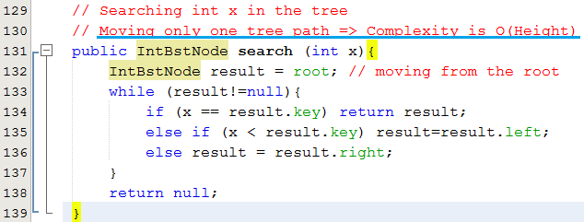
Alg.: Searching data x
The IntBstTree class

Slide 27
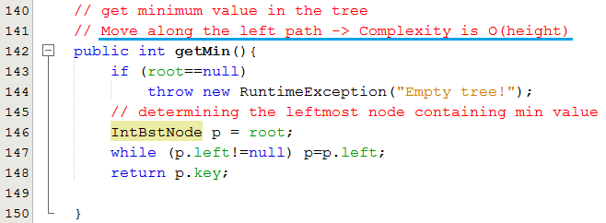
Alg.: Get minimum value
The IntBstTree class

Slide 28
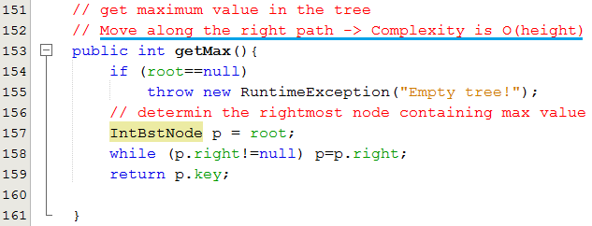
Alg.: Getting maximum value
The IntBstTree class

Slide 29
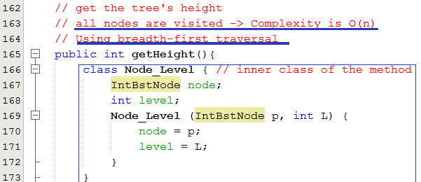
Alg.: Get tree’s height
The IntBstTree class

Slide 30
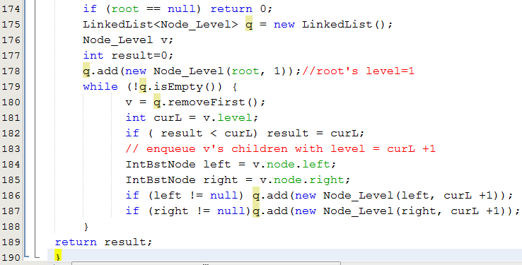
Alg.: Get tree’s height
The IntBstTree class

Slide 31
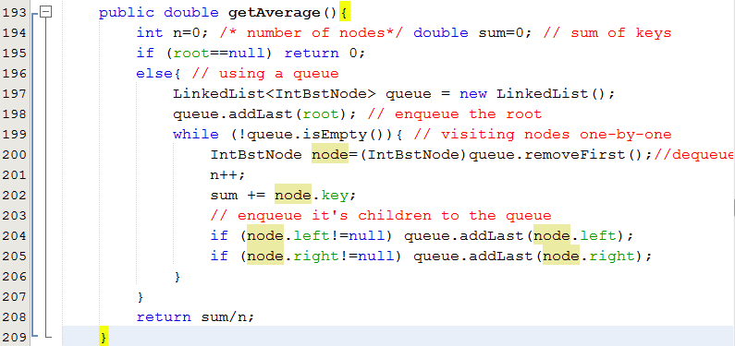
Alg.: Getting average value
The IntBstTree class

Slide 32
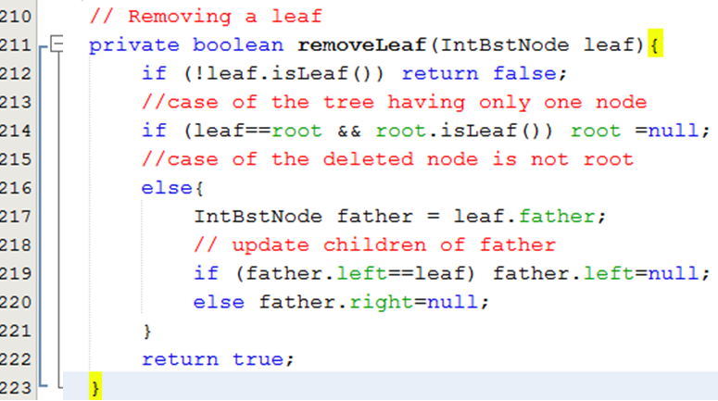


Alg.: Removing a leaf
The IntBstTree class
O(1)
root

Slide 33
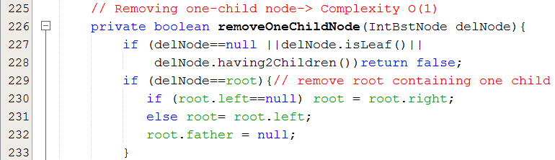
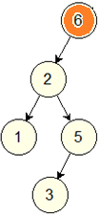
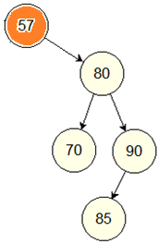
Alg.: Remove one-child node
The IntBstTree class

Slide 34
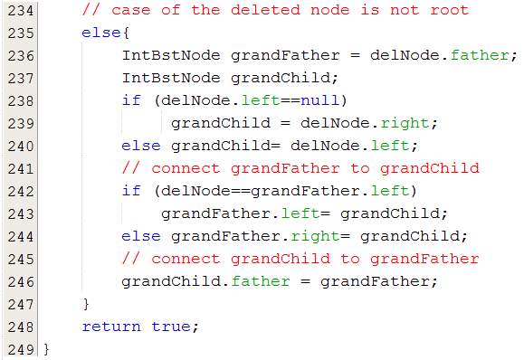
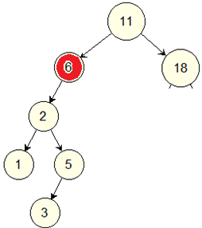
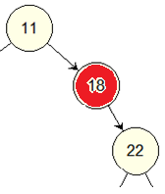
Alg.: Remove one-child node
The IntBstTree class

Slide 35
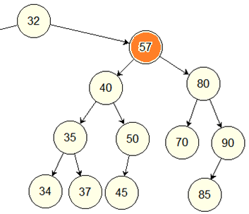
Alg.: Delete 2-child node by merging
The IntBstTree class
delNode
grandFather
The tree’s height may increase
(this example)
leftGrandChild
rightGrandChild
rightMost
rightMost

Slide 36
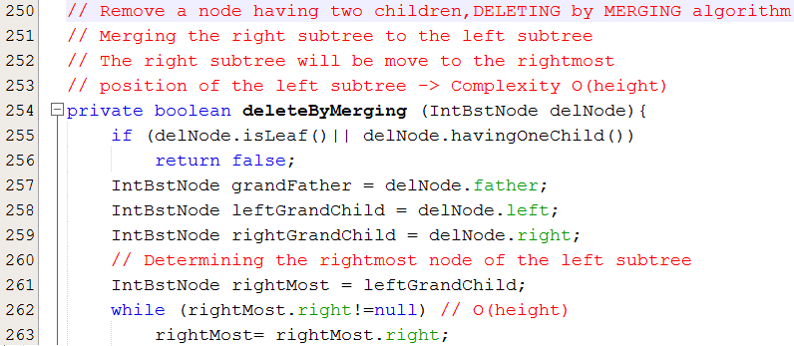
Alg.: Delete 2-child node by merging
The IntBstTree class

Slide 37
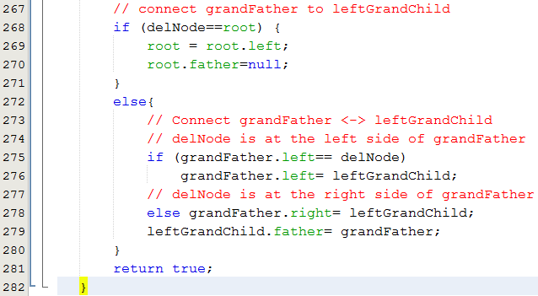
Alg.: Delete 2-child node by merging
The IntBstTree class

Slide 38
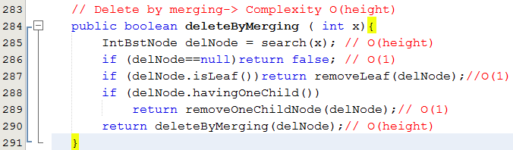
Alg.: Delete 2-child node by merging
The IntBstTree class

Slide 39
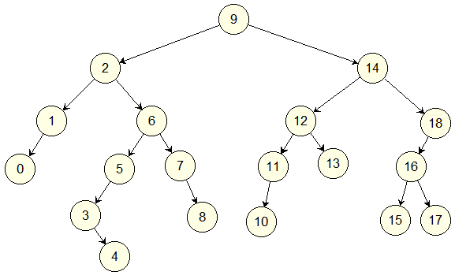
Delete a node by merging
After the node 1 was deleted, what is father of the node 0?
After the node 4 was deleted, what is child of the node 3?
After the node 5 was deleted what is father of the node 4?
After the node 14 was deleted, what is father of the node 18?

Slide 40
Delete a node by merging
After the node 9 was deleted, what is father of the node 2?
After the node 9 was deleted, what is child of the node 14?
After the node 6 was deleted what is father of the node 5?
After the node 11 was deleted, what is father of the node 10?

Slide 41
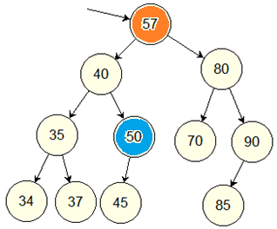
Alg.: Delete 2-child node by copying
The IntBstTree class
delNode
The delNode is preserved.
Copy data from the rightMost node to delNode.
Remove the rightMost node.
The tree’s height is preserved.
rightMost

Slide 42
Alg.: Delete 2-child node by merging
The IntBstTree class

Slide 43
Delete a node by copying
After the node 1 was deleted, what is father of the node 0?
After the node 4 was deleted, what is child of the node 3?
After the node 5 was deleted what is father of the node 4?
After the node 14 was deleted, what is father of the node 18?

Slide 44
Delete a node by copying
After the node 9 was deleted, what is father of the node 2?
After the node 9 was deleted, what is child of the node 14?
After the node 6 was deleted what is father of the node 5?
After the node 11 was deleted, what is father of the node 10?

Slide 45
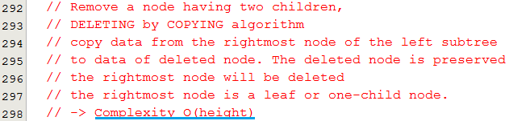
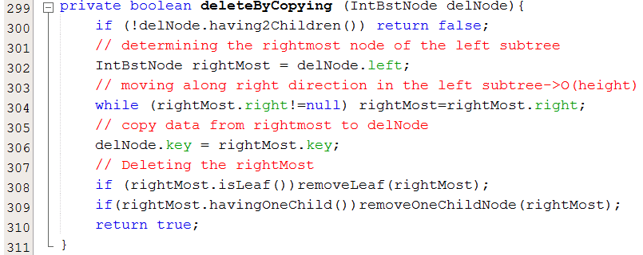
Alg.: Delete 2-child node by copying
The IntBstTree class

Slide 46
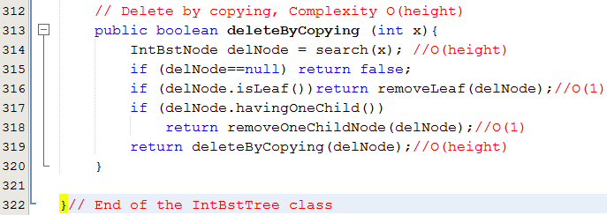
Alg.: Delete 2-child node by copying
The IntBstTree class

Slide 47
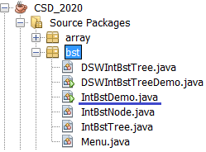
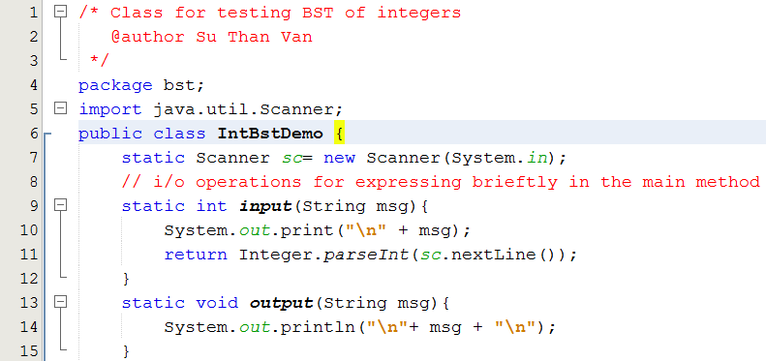
Test Program

Slide 48
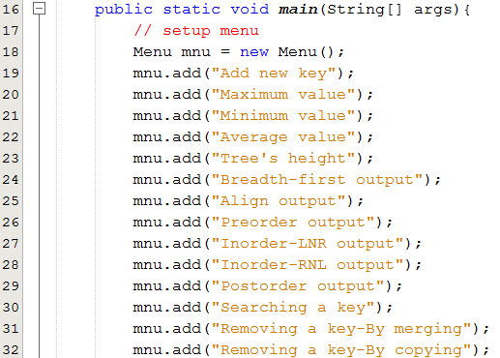
Test Program
The IntBstDemo class

Slide 49
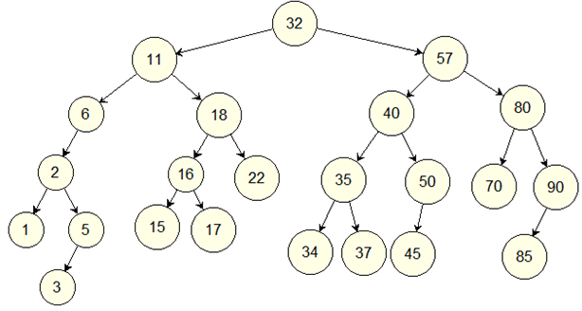
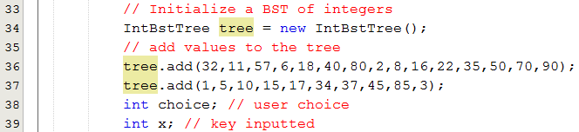
Test Program
The IntBstDemo class

Slide 50
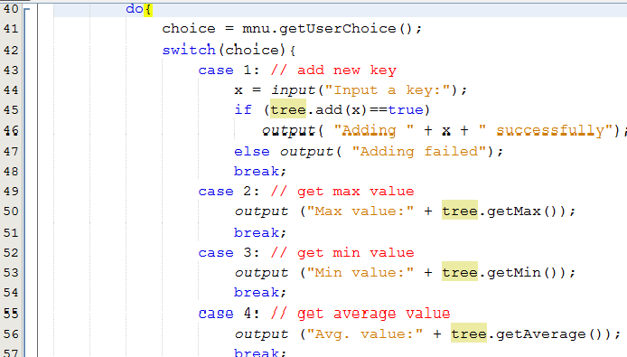
Test Program
The IntBstDemo class

Slide 51
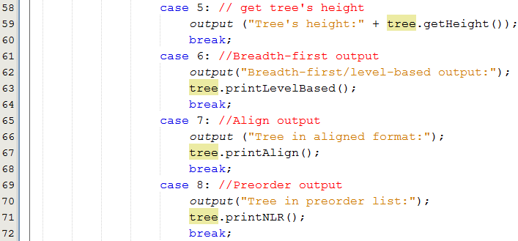
Test Program
The IntBstDemo class

Slide 52
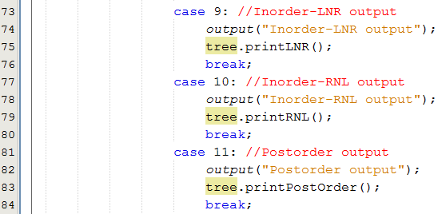
Test Program
The IntBstDemo class

Slide 53

Test Program
The IntBstDemo class

Slide 54

Test Program
The IntBstDemo class

Slide 55
Evaluating BSTs: Advantages
Operations including Adding, searching, removing are improved with complexity of O(tree’s height), less than O(number of items).
Sort operation is omitted because data in the tree are always sorted.
If the tree is a complete binary tree, the tree’s height will be minimum. In this case, operations on the tree are optimal.

Slide 56
Evaluating BSTs: Disadvantages
Tree’s height depends mainly on order of data added. This situation of complete BST is very hard to occur in normal problem.
In case of the BST is degraded, almost of data are at one direction, operations will have complexity of O(number of nodes) ← Hm Hm

Slide 57
Evaluating BSTs
Structure | Add | Search | Remove
Array | O(1), O(n) | O(n) | O(n)
Linked list | O(1), O(n) | O(n) | O(1)
BST | O(height) | O(height) | O(height)

Slide 58
Summary: All LO are met.

LO4.1 Define general tree, Binary Tree and Binary Search Tree (BST).
LO4.2 Given a BST , draw resulted tree after an insert/ delete operations
LO4.3 Find the smallest and largest elements, number of nodes in a
tree and its’ height.



Slide 59
Summary: All LO are met.

LO4.4 Write code to implement features of a binary search tree, such as insertion, deletion, searching, traversals, nodes and height calculation, rotation ...
LO4.5 Derive the time complexities for the above operations on a BST.
LO4.6: Compare a BST over other data structures
LO4.7: Identify applications where a binary search tree will be useful.




Slide 60
Ôn tập- Viết vào vở
Hãy vẽ một cây BST tuỳ ý sau đó cho kết quả của các phép duyệt: NLR, NRL, LNR, RNL, LRN, RLN.
Thứ tự tự nhiên là gì? Giải thích lý do.
Để một nút trong cây BST có thể chứa object, class của object này cần phải được khai báo thế nào?
Hãy vẽ một cây BST tuỳ ý sau đó giải thích việc thêm một nút mới vào cây này.
Hãy viết vào vở 16 thao tác xoá trên 4 bài thí dụ trong slide này và cho kết quả.
Các trị sau được đưa vào cây BST trống theo thư tự: 3 5 7 9 2 4 6 8 1. Sau khi xoá nút 4, nút 3 là con của nút nào?
Các trị sau được đưa vào cây BST trống theo thư tự. Hỏi số phép so sánh phải tiến hành khi tìm trị 12. 3 5 7 9 2 4 6 8 1.
Giả sử nút gốc của cây nhị phân có mức 1. Hỏi số nút tối đa ở mức 10.
Các trị sau được đưa vào cây BST trống theo thư tự 3 5 7 9 2 4 6 8 1. Hãy cho biết kết quả của phép duyệt theo chiều rộng.

Slide 61
Next part: Balanced BST and Heap Structure

